Slide 1
UNIT-IV
S. A. Tiwaskar

Slide 2
PDA
The PDA is an automaton equivalent to the CFG in language-defining power.
Only the nondeterministic PDA defines all the CFL’s.
But the deterministic version models parsers.
Most programming languages have deterministic PDA’s.

Slide 3
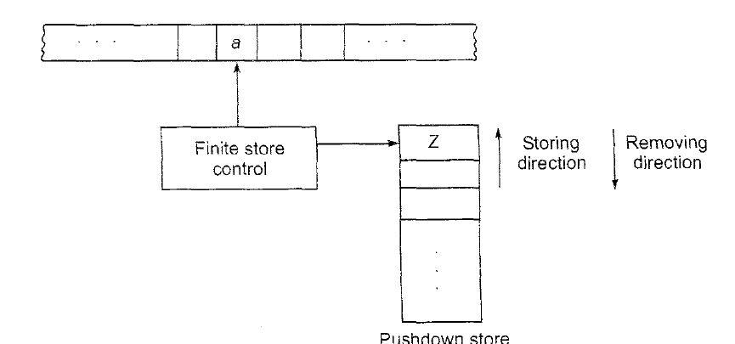
Model of a Pushdown automaton

Slide 4
PDA
A PDA is described by:
1. A finite set of states (Q, typically).
2. An input alphabet (Σ, typically).
3. A stack alphabet ( Γ, typically).
4. A transition function (δ, typically).
5. A start state (q 0, in Q, typically).
6. A start symbol (Z 0, in Γ, typically).
7. A set of final states (F ⊆ Q, typically)

Slide 5
PDA
Its moves are determined by:
1. The current state
2. The current input symbol (or ε), and
3. The current symbol on top of its stack

Slide 6
The Transition Function
The Transition Function has three arguments:
1. A state, in Q.
2. An input, which is either a symbol in Σ or ε.
3. A stack symbol in Γ.
δ(q, a, Z) is a set of zero or more actions of the form (p, α).
p is a state; α is a string of stack symbols

Slide 7
Actions of the PDA
If δ(q, a, Z) contains (p, α) among its actions, then one thing the PDA can do in state q, with a at the front of the input, and Z on top of the stack is:
1. Change the state to p.
2. Remove a from the front of the input (but a may be ε).
3. Replace Z on the top of the stack by α

Slide 8
Example: PDA
Design a PDA to accept {0^{n}1^{n} | n > 1}.
The states:
q = start state. We are in state q0 if we have seen only 0’s so far.
p = we’ve seen at least one 1 and may now proceed only if the inputs are 1’s.
f = final state; accept

Slide 9
Example: PDA – (2)
The stack symbols:
Z0 = start symbol. Also marks the bottom of the stack, so we know when we have counted the same number of 1’s as 0’s.
All 0’s we will push in the stack

Slide 10
Example: PDA – (3)
Note: we are pushing all 0’s in the stack and popping one 0’s from the stack when 1 is appearing in the input
The transitions:
δ(q, 0, Z0) = {(q, 0Z0)}.[first 0 is pushed in the stack]
δ(q, 0, 0) = {(q, 00)}. [Subsequent 0’s pushed in the stack]
Above two rules cause all 0 ‘s to be pushed onto the stack from the input.
δ(q, 1, 0) = {(p, ε)}. When we see a 1, go to state p and pop one 0.
δ(p, 1, 0) = {(p, ε)}. Pop one 0 per 1.
δ(p, ε, Z0) = {(f, Z0)}. Accept at bottom.[when input is over PDA will go to final state f]

Slide 11
Instantaneous Descriptions
Instantaneous description (ID).
A ID is a triple (q, w,α ), where:
1. q is the current state.
2. w is the remaining input.
3. α is the stack contents, top at the left.

Slide 12
The “Goes-To”(Move ) Relation
To say that ID I can become ID J in one move of the PDA,
we write I ⊦J.
Formally, (q, aw, X α ) ⊦(p, w, βα) for any w and α, if δ(q, a, X) contains (p, β).
Extend ⊦ to ⊦*, meaning “zero or more moves,”

Slide 13
Example: Goes-To
Using the example {0^{n}1^{n} | n > 1} PDA. we can describe the sequence of moves by:
(q, 000111, Z0)⊦(q, 00111, 0Z0)⊦ (q, 0111, 00Z0)⊦(q, 111, 000Z0)⊦ (p, 11, 00Z0)⊦(p, 1, 0Z0)⊦(p, ε, Z0)⊦ (f, ε, Z0)
Thus, (q, 000111, Z0)⊦*(f, ε, Z0).
What would happen on input 0001111?

Slide 14
Answer
(q, 0001111, Z0)⊦(q, 001111, 0Z0)⊦ (q, 01111, 00Z0)⊦(q, 1111, 000Z0)⊦ (p, 111, 00Z0)⊦(p, 11, 0Z0)⊦(p, 1, Z0)
Note the last ID has no move.
0001111 is not accepted, because the input is not completely consumed.

Slide 15
Example PDA
Design a PDA to accept {a^{n}b^{n} | n > 1}.
The transitions:
δ(q0, a, Z0) = {(q0, aZ0)}.[first ‘a ‘is pushed in the stack]
δ(q0, a, a) = {(q0, aa)}. [Subsequent ‘a’s pushed in the stack]
Above two rules cause all a ‘s to be pushed onto the stack from the input.
δ(q0, b, a) = {(q1, ε)}. When PDA sees ‘b’, go to state q1 and pop one a.
δ(q1, b, a) = {(q1, ε)}. Pop one ‘a’ per ‘b’.
δ(q1, ε, Z0) = {(qf, Z0)}. Accept at bottom.[when input is over PDA will go to final state qf]

Slide 16
Example PDA
Q={q0,q1,qf},

Slide 17
Example PDA
Design a PDA For the language {x | x = wcw^{r} and w in {a,b}*, or {x | x = wcw^{T} and w in {a,b}*,
[Note: Design strategy is w will be pushed in the stack, c will be rejected PDA will change the state to remember c is encountered and for ‘wT’, ‘w’ will be popped from the stack] w is string over {a,b}
A = ({qo, q1, qf}, {a, b,c}, {a, b, zo}, δ, qo, Zo, {qf}) where δ is given below
δ(q0, a, Z0) = {(q0, aZ0)}.[first ‘a’ is pushed in the stack]
δ(q0, a, a) = {(q0, aa)}. [Subsequent a’s pushed in the stack]
δ(q0, b, Z0) = {(q0, bZ0)}.[first ‘b’is pushed in the stack]
δ(q0, b, b) = {(q0, bb)}. [Subsequent ‘b’s pushed in the stack]
[Above 4 rules will be used for handling input string ‘w’]

Slide 18
Example PDA Conti…
[Following 3 rules will be used for handling input symbol ‘c’]
δ(q0, c, Z0) = {(q1, Z0)}.[this rule will be used when ‘w’ and obviously ‘wT’ is null]
δ(q0, c, a) = {(q1, a)}
δ(q0, c, b) = {(q1, b)}
δ(q1, a, a) = (q1, ε) [PDA erases the topmost symbol if it coincides with the current input symbol]
δ(q1,b, b) = (q1, ε) [PDA erases the topmost symbol if it coincides with the current input symbol]
δ(q1, ε, Z0) = {(qf , Z0)}[PDA reaches the final state qf only when the input string is exhausted and then the PDS has only Z0]

Slide 19
Validity Testing
Using the example {x= wcw^{r} and w in {a,b}*, } PDA. we can describe the sequence of moves by:
(q0, abcba, Z0)⊦(q0, bcba, aZ0)⊦ (q0, cba, baZ0)⊦(q0, cba, baZ0)⊦
(q1, , ba, baZ0)⊦ (q1, a, aZ0) ⊦ (q1, ε, Z0) ⊦ (qf, ε, Z0)
Thus, (q0, abcba, Z0)⊦*(qf, ε, Z0).
So input string ‘abcba’ is accepted by PDA
What would happen on input aacbb?

Slide 20
Validity Testing
Answer
(q0, aacbb, Z0)⊦(q0, acbb, aZ0)⊦ (q0, cbb, aaZ0)⊦(q1, bb, aaZ0)⊦
(q1, , bb, aaZ0)⊦
Note the last ID has no move.
so input ‘aacbb’ is not accepted, because the input is not completely consumed.

Slide 21
Acceptance by Final state example
Design a PDA For the above language by final state
[Note: Design strategy is all ‘a’ s will be pushed in the stack, all ‘b’ s will be rejected PDA will change the state to remember b is encountered and trailing ‘a’s will be popped from the stack]
A = ({qo, q1, qf}, {a, b}, {a, zo}, δ, qo, Zo, {qf}) where δ is given below
δ(q0, a, Z0) = {(q0, aZ0)}.[first ‘a’ is pushed in the stack]
δ(q0, a, a) = {(q0, aa)}. [Subsequent a’s pushed in the stack]
[Above 2 rules will be used for pushing all ‘a’ s in the stack]

Slide 22
Example PDA Conti…
[Following 2 rules will be used for handling input ‘b’]
δ(q0, b, a) = {(q1, a)}
δ(q1, b, a) = {(q1, a)}
δ(q1, a, a) = (q2, ε) [PDA erases the topmost symbol if it coincides with the current input symbol and changes the state from q1 to q2]
δ(q2, a, a) = {(q2 , ε )}
δ(q2, ε, Z0)=(qf, Z0)[PDA reaches the final state qf only when the input string is exhausted and then the PDS has only Z0]

Slide 23
Acceptance by PDA
The common way to define the language of a PDA is by final state
If P is a PDA, then L(P) is the set of strings w such that (q 0, w, Z 0) ⊦* (f, ε, α) for final state f and any α.
Another language defined by the same PDA is by empty stack.
If P is a PDA, then N(P) is the set of strings w such that (q 0, w, Z 0) ⊦* (q, ε, ε) for any state q

Slide 24
Deterministic PDAs
To be deterministic, there must be at most one choice of move for any state q, input symbol a, and stack symbol X.
In addition, there must not be a choice between using input ε or real input.
Formally, δ(q, a, X) and δ(q, ε, X) cannot both be nonempty
Examples of PDA which we have seen till now is deterministic PDA

Slide 25
HW
Design a PDA for the following for acceptance by final state
L={0^{n}1^{m}0^{n}|m,n>=1}
L={a^{n}b^{2n}|n>=1}
L={a^{n} b ^{m} c ^{n}| m,n>=1}

Slide 26
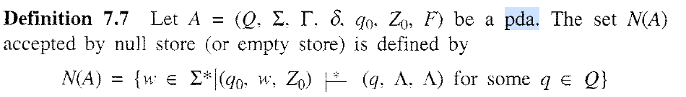
Acceptance of PDA by Null store or Empty stack

Slide 27
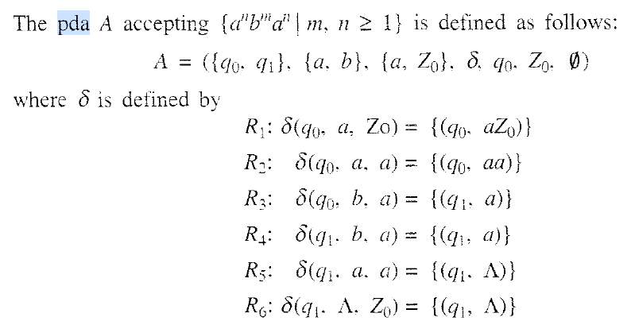
Example

Slide 28
Validity Testing
Do validity testing for the string
aabaa
abbaa
aaabaa

Slide 29
HW
Design a PDA for the following for acceptance by Null store or empty stack.
L={0^{n}1^{m}0^{n}|m,n>=1}
L={a^{n}b^{2n}|n>=1}
L={a^{n} b ^{m} c ^{n}| m,n>=1}

Slide 30
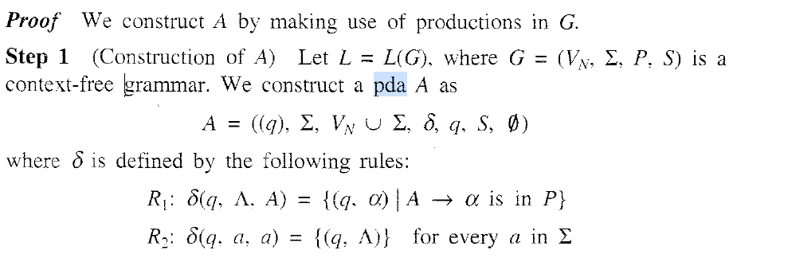
PDA & Context Free Grammar(CFG)

Slide 31
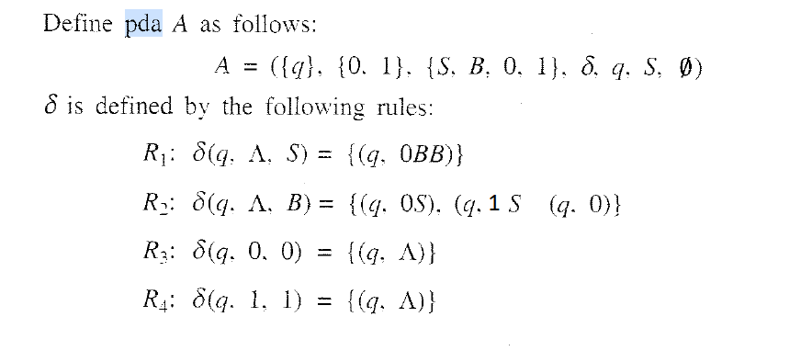

Slide 32

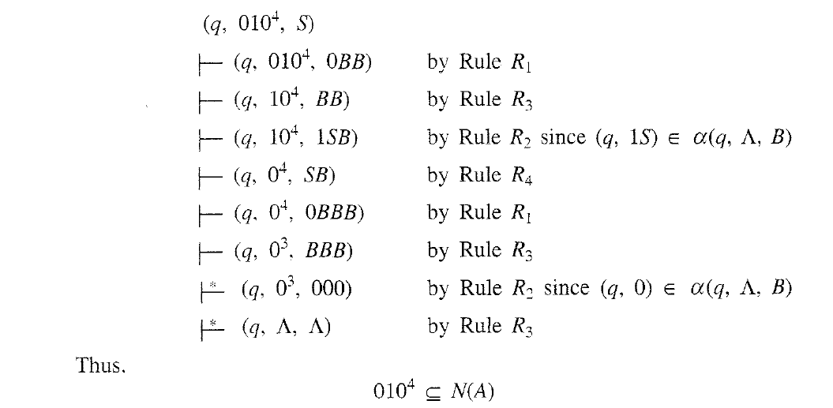
Validity Testing

Slide 33
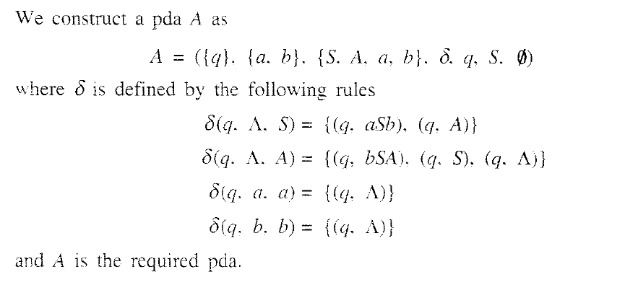
Example 2 CFG to PDA Conversion

Slide 34
Validity Testing
Test whether the string “abab” is in N(A)
(q,abab,S) |--(q,abab, aSb) |--(q, bab, Sb) |-- (q,bab, Ab) |---(q, bab,bSab)
|--(q,ab,Sab) |--(q, ab, ab) |---(q, ab,ab) |--(q,b, b) |---( q, , )

Slide 35
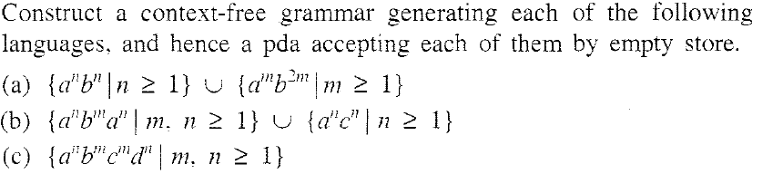
HW
G=({S,A, B}),{a,b},P,{S}) b) G=({S,X,Y,Z}),{a,b, c},P,{S}) C) G=({S, A, B}, {a,b,c,d},P S)
S-> A | B S-> X | Y S-> A
A-> ab | aAb Y-> ac | aYc A->aAd | aBd
B-> abb | aBbb X->aXa | aZa B->bc | bBc
Z->b | bZ

Slide 36
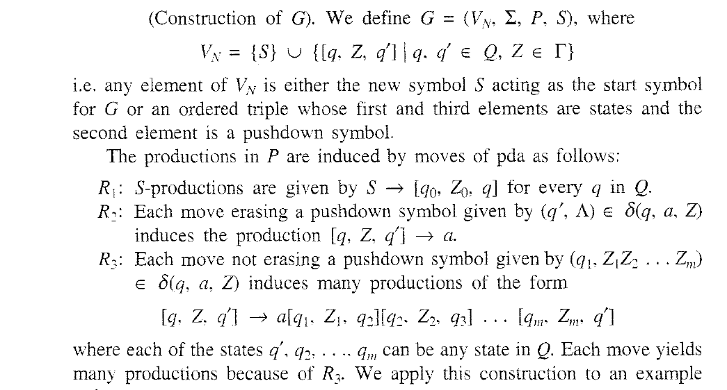
Construction of CFG from PDA

Slide 37
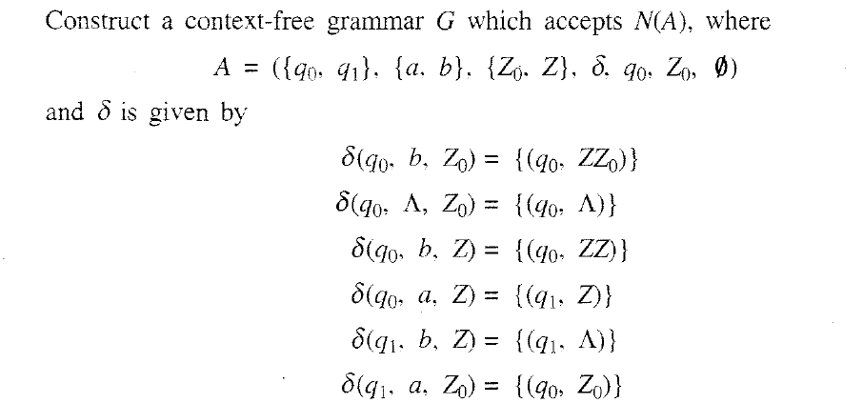
Example

Slide 38

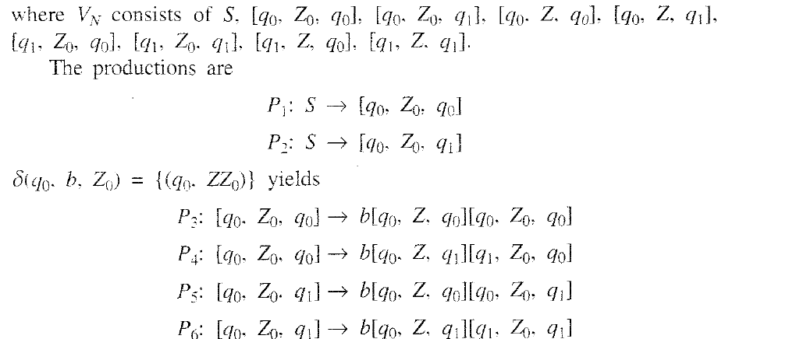
Solution

Slide 39
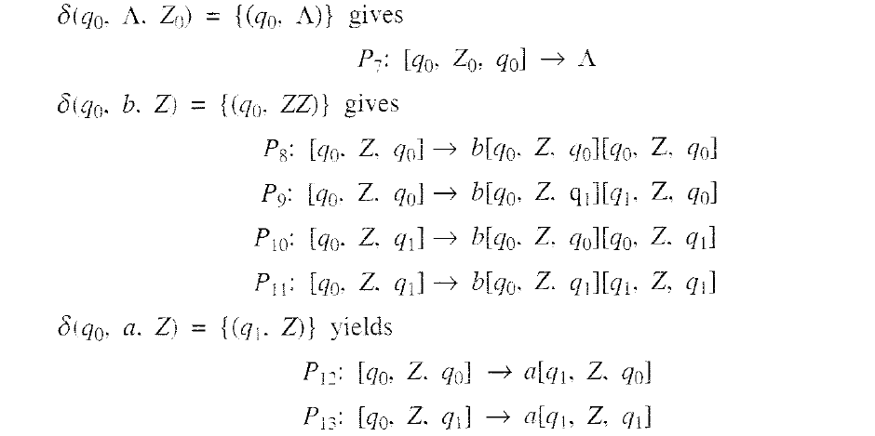
Solution Conti..

Slide 40
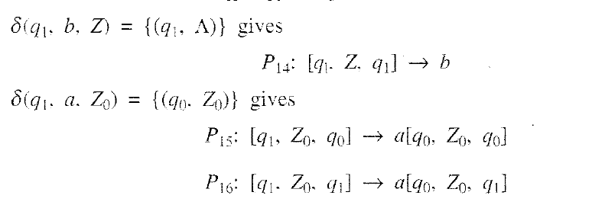
Solution Conti..
P1-P16 give the productions in P

Slide 41
Example
Solution

Slide 42
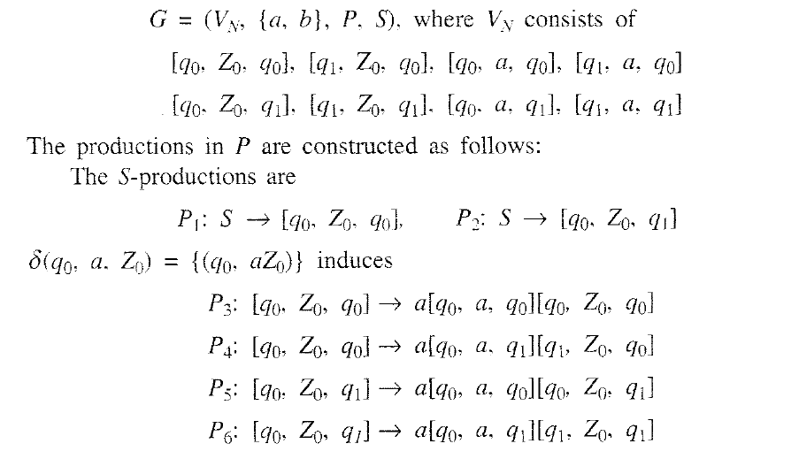
Solution Conti…

Slide 43
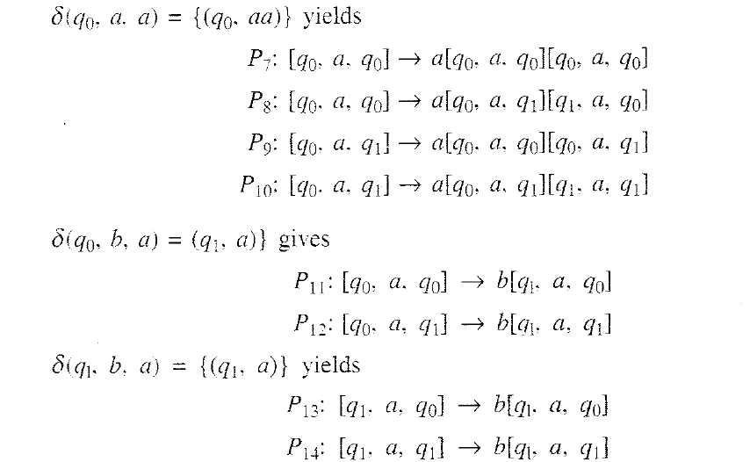
Solution Conti…

Slide 44
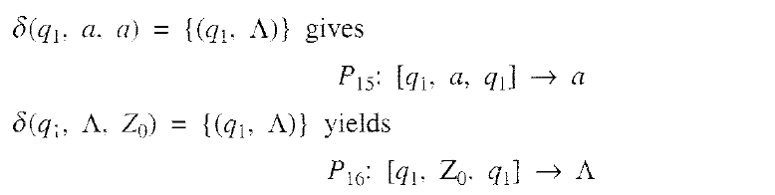
Solution Conti…

